Slide 1
MIDTERM PRESENTATION
TANMAY INGLE, BHASKAR AKULA
Big Data Analytics

Slide 2
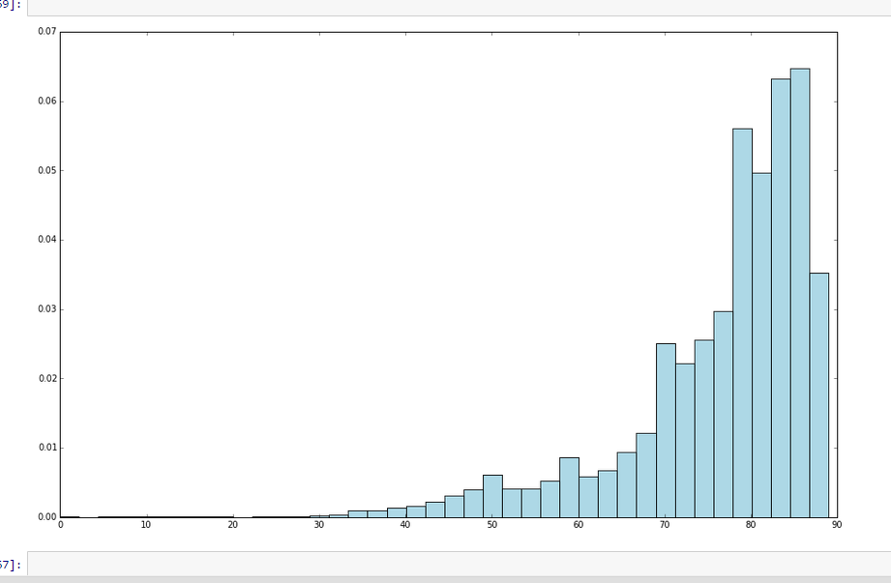
Case1: Year of Song(Classification and Regression)
Preprocessing
Label Shifting
Histogram of Target Variable
Standardization

Slide 3
Regression – Model
Split – 70,30
Metric - RMSE
LinearRegressionWithSGD – 10.5
RidgeRegressionWithSGD – 9.55
LassoRegressionWithSGD – 10
Interpretation

Slide 4
Classification - Model
Make labels(<1965)
Metrics – Accuracy, Area Under ROC Curve, Area under Precision-Recall Curve
3 Models
LogisticRegressionwithSGD
Accuracy – 0.65
AUC – 0.84
AU PRC – 0.91
PCA SVD

Slide 5
Case:2 Income Classification
Preprocessing
Handling Missing Data
Remove unwanted columns(education_nums)
Convert Categorical into dummy variables
Convert <50, >=50 to 0 and 1
Standardization

Slide 6
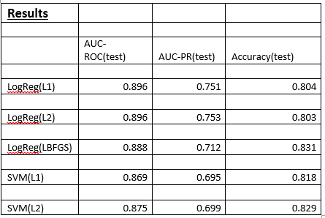
Metrics - Comparison

Slide 7
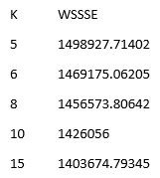
Case:3 Clustering – TV Commercials
Preprocessing
LIBSVM format
Union
Standardization – Important in clustering
K-means
K = 5,6,8,10,15
WSSSE – within sum set of squared error
Elbow chart

Slide 8
Lessons Learnt and Challenges Faced
Scala – not interactive, takes time, tuning is tough
Solution – ML Pipelines, Clusters
Caching was a problem with large dataset
Gaussian Mixture had java heap space issues

Slide 9
Thank You

